Slide 1
Safer Communities:
County Lines and Knife Crime
Simon Ford
Director, Violence and Vulnerability Unit

Slide 2
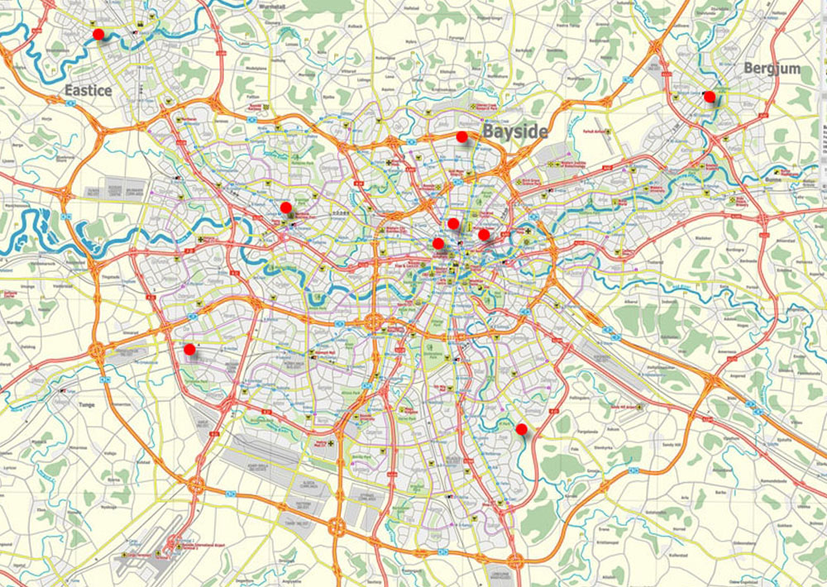
Local action planning to tackle gangs and criminal exploitation
Simon Ford
Head of Community Safety Programme Director
Southend Borough Council Violence and Vulnerability Unit
simonford@southend.gov.uk Home Office

Slide 3
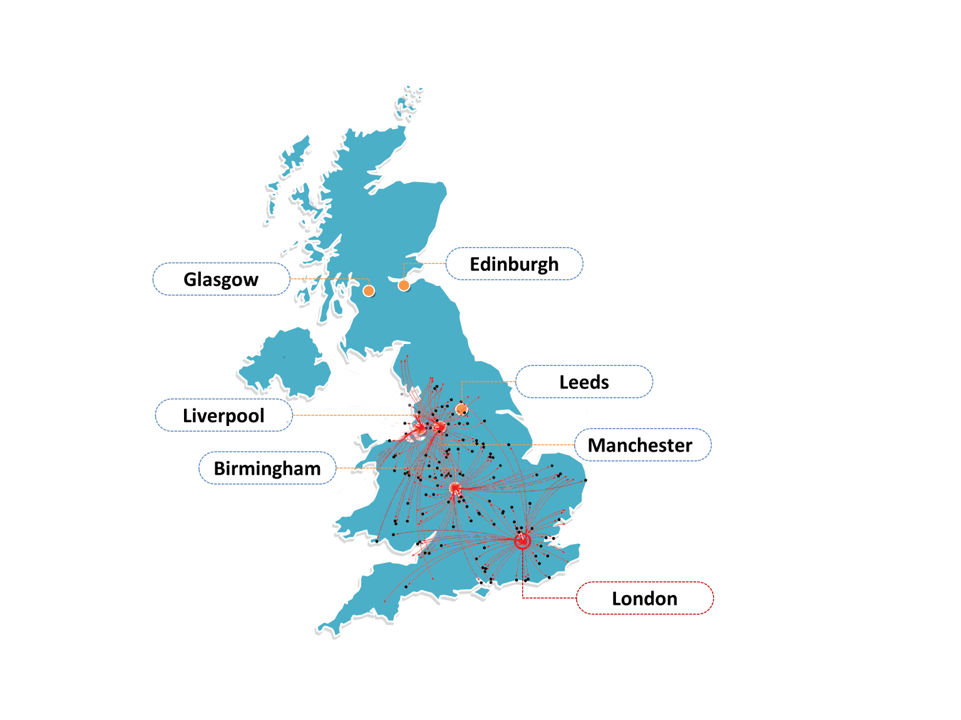
New methodology has identified ‘county lines’ as an extensive network of organised crime
Gangs
Urban gangs coming from London, Birmingham, Bristol, Manchester Liverpool and other urban centres to supply Class A drug markets to rural and seaside towns.
Notes:
We are all aware of the national picture of how county lines has developed

Slide 4
THE DRUG MARKET is fuelling this new type of criminal activity
The size of local drug markets is unknown as we can only see the problematic usage and not the recreational drug use.
But we know that……..
The fact that there are an estimated 2000 lines in operation around the country at any one time would suggest these markets are sizeable and extremely lucrative.
There is an increase in heroin/crack cocaine/cocaine use especially amongst young people.
There are price wars between rival gangs;- price cutting gimmicks/bogof/raffles
Xanax + Fentanyl becoming an increasing issue
Notes:
And we know that the local drug markets are fuelling this but very little is known about the actual size of the market.

Slide 5
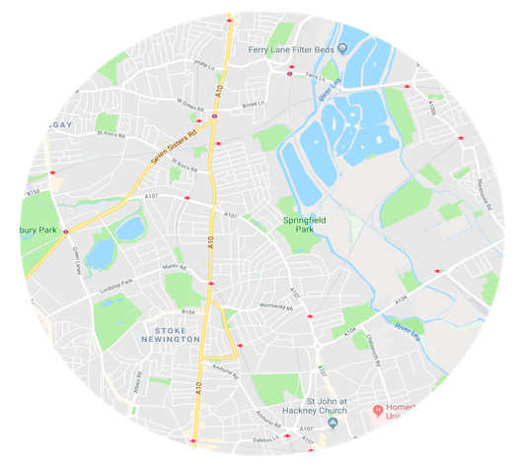
This gang activity is taking place against a back drop of shrinking services. Gangs are moving into the vacuum left by service reduction and exploiting vulnerable populations who are losing contact with protective services
Drug Service waiting
times
Early
intervention
services
Adult
Drop In
Services
Antisocial
Behaviour
Services
VULNERABLE YOUNG PEOPLE
VULNERABLE ADULTS
ASB
Teams
Gangs
Outreach
services
Youth service provision
Third
Sector
Support
Notes:
The Children of Austerity. We know that the vacuum left by a shrinking youth and community sector is being exploited by gangs and all forms of criminal exploitation

Slide 6
Resulting in systematic exploitation
Child Sexual
Exploitation
VULNERABLE YOUNG PEOPLE
Criminal Exploitation
VULNERABLE ADULTS (18-25)
Gangs
VULNERABLE ADULTS
Modern Slavery
Notes:
This has led to systemic exploitation which is a recognised pattern in local areas

Slide 7
So how do we tackle this locally?

Slide 8
SO WHOSE RESPONSIBILITY IS IT
TO MANAGE THESE ISSUES?
In Southend, each of the local Strategic Boards i.e. CSP, LSCB,SAB, HWBB have responsibility for managing part of this overall picture
New strategic group established-
Violence and Vulnerability Strategic Group drawn from all 4 Boards
Offers a support and challenge role to all 4 Boards to ensure they deliver on work plan

Slide 9
JULY 2018-
LOCAL ACTION TO ADDRESS THESE ISSUES.
A new V+V Action Plan:
Understanding the problem ;- analysis, data and intelligence (Dashboard)- Creating a data set which indicates activity and movement.
Prepare- how to create local conditions where it is hard for gangs to exploit vulnerable people. –Publicity/awareness campaigns/community engagement
Prevent – comprehensive strategy to train staff in schools/social care/ health agencies voluntary agencies
Protect/Safeguarding – vulnerable children and adults activity, screening/identification/intervention
Pursue- identifying, monitoring and managing perpetrators
Community Engagement- begin a stronger and on going dialogue with the community to engage them in the issue and create an alliance to help with the flow of information and in the inhibition of gang and drug dealing activity
Notes:
Last year in Southend we brought this together under one Action Plan.

Slide 10


COUNTY LINES, DRUG AND GANG ACTIVITY DASHBOARD
THIS IS ANYTOWN
xxx
How many lines are coming into the town?
21
Where are they coming from?
Is this increasing or decreasing?
London 1 line 1group
Birmingham 10 lines 3 groups
Manchester 4 lines 1 group
Merseyside 6 lines 2 groups
Arrests
How many drug arrests in the past month? (Young people and Adults)
12
Arrests made this month
4
Appropriate Adult interviews
Youth
How many juveniles have been identified?
How many PWITS? (possession with intent to supply)
How many from inside the town?
How many from other places?
How many safeguarding assessments (S17 and S47) have identified Drug/CSE/gang activity?
How many referrals to the NRM?
Missing from Education (missing from school on a regular or consistent basis)
Missing from Home (more than 3 times)
XX
4
X
X
5
X
X
X
Adult
How many cuckooed houses have been identified?
How many have been charged with trafficking/modern slavery offences?
How many closure orders have been applied for?
Health
How many knife /Gun wounding appearing at frontline health services (A & E)
34
4
2
2

Slide 11
Child Sexual
Exploitation
VUNERABLE YOUNG PEOPLE
CSP
ACTIVITY
Police operations
Civil Powers (ASB Act)
Multi agency focus on Perpetrators (ISA in place)
Wider regional considerations (cross border work)
LSCB
ACTIVITY
New Risk Assessment Tool (CE + CSE) to ensure capture of those being targeted.
Education and training for young people and staff in youth / schools and community agencies
Referrals to NRM
Specialist staff working with young people (OP CENSOR)
SAB
ACTIVITY
Training on Gangs/modern slavery and criminal exploitation for; all housing workers, voluntary staff,
Specialist adult social care worker to work with vulnerable adults involved in CL
Developing new Risk Assessment Tool to capture vulnerable adults at risk ( eg cuckooing)
HEALTH AND WELLBEING BOARD
ACTIVITY
Training for all health staff on all aspects of gangs and related exploitation activity
Public Health tasked with assessing local drug markets
A&E involvement (Cardiff model)
PR Campaign /Comms (counter narrative)
Criminal Exploitation
VULNERABLE ADULTS (18-25)
Gangs
VUNERABLE ADULTS
Modern Slavery
Notes:
This indicates the activity fits under the remit of each board to tackle each section of the exploitation system. The task is to bring it together in a co-ordinated and structured way.

Slide 12


Slide 13
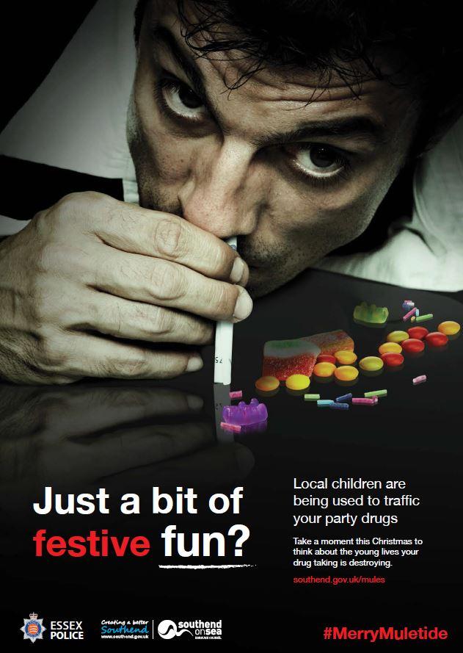

Slide 14
The Coming Year for us……
Community Engagement
- Statutory services cannot manage this problem on its own
- Need the 3rd Sector groups and agencies
- Community and residents groups have to be an active partner
- Concentrated effort in the coming year to mobilise the energy and
expertise from the community.
Performance Monitoring
- establish some KPIs so we can measure our impacts

Slide 15
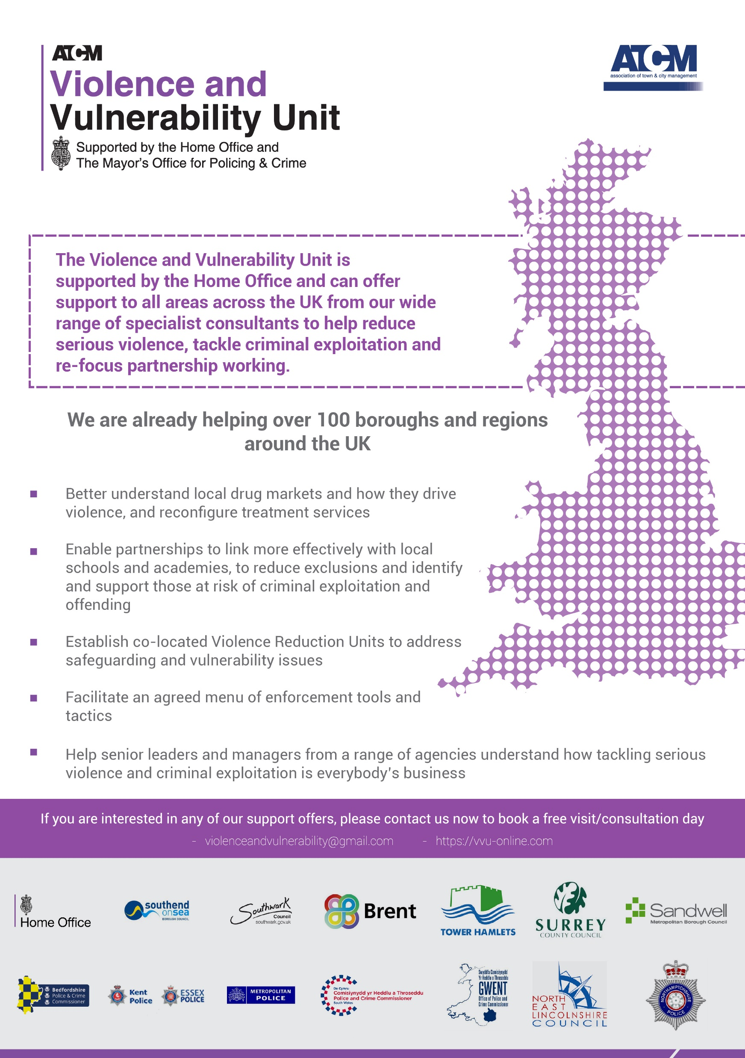

Slide 16
