Slide 1
Safer Communities:
County Lines and Knife Crime
Lucy Belcher
Service Manage, The Children’s Society

Slide 2
Child Criminal Exploitation
Lucy Belcher
Service Manager
National Exploitation Prevention Programme
Notes:
At TCS, we have three national programmes that focus on exploitation.
Tackling Child Exploitation – this is a brand new programme in partnership with University of Bedfordshire and Research in Practice. Local areas – not just local authorities can apply for bespoke support. The programme are now taking applications – closes on 19th Nov. The programme will also host a website which will promote resources, guidance and policy for multi-agency professionals to use.
Disrupting Exploitation – this is a three year programme funded by the Big Lottery – it runs in London, Birmingham and Manchester and each area has a small local team working directly with young people at risk of or being criminally exploited and they also work to change the systems which are failing young people. This programme was set up on the principle of ‘different children, same problem’. As we all know, through our work and the young people we support, they are different children but they are all facing the same problems in the systems surrounding them. Whether that was the criminal justice system, police, education, health, social care or in the community. So our teams were set up to empower frontline practitioners to not only work with young people directly but work with the systems around young people to better protect them.
Prevention programme – this programme ran in 2017-2018 and has recently been refunded from April this year til March 2020. We have ten prevention officers all working in designated policing regions across England and Wales. We do not work directly with young people but we work closely with Regional Organised Crime Units to deliver preventative activity (tasks) in relation to sexual exploitation, criminal exploitation and modern slavery. A lot of our work consists of contextual safeguarding approaches; we raise awareness and train to what we call ‘unusual partners’, We work with ‘unusual partners’ to deliver contextual safeguarding approaches.
We often talk about ‘whole systems approach’ to tackling exploitation – which we do need. We also need to be identifying the parts of the system that we are working in that need changing and work together to tackle this.
We do this across all three national programmes– empowering the workforce to be system changers and designing & delivering frontline programmes with an explicit systems change focus
We cannot do this in isolation and have to work in partnership with everyone – young people, parents and carers included in this. Our learning from our direct work directly feeds into our programmes.

Slide 3

The Children’s Society – who we are
National charity delivering in England & Wales:
  local support to children and young people
  policy, research, campaigning and youth engagement
Our expertise lies particularly in:
  Child sexual and criminal exploitation (CSE and CCE)
  Children in care
  Substance and alcohol misuse
  Refugee and migrant children
  Mental health and well-being
138 years old
71 frontline services
780 staff
Notes:
The Children’s Society is a voluntary sector organisation with 140 years’ experience of supporting some of the most vulnerable children. We are particularly focusing on vulnerable adolescents, those who are affected by child sexual exploitations, child criminal exploitation. We run direct services, supporting children one to one and through the group work but also advocate for changes to policy and guidance through our policy, research and campaigns.

Slide 4
Young person’s definition
Working together guidance definition
‘when someone you trusted makes you commit crimes for their benefit’
Child Criminal Exploitation occurs where an individual or group takes advantage of an imbalance of power to coerce, control, manipulate or deceive a child or young person under the age of 18 into any criminal activity (a) in exchange for something the victim needs or wants, and/or (b) for the financial or other advantage of the perpetrator or facilitator and/or (c) through violence or the threat of violence. The victim may have been criminally exploited even if the activity appears consensual. Child Criminal Exploitation does not always involve physical contact; it can also occur through the use of technology.
Notes:
Before presenting the findings of the research I wanted to provide a bit of a context in terms of definition we used and legal frameworks we explored.
Firstly the definitions. This research focussed on child criminal exploitation and the county lines model of child criminal exploitation specifically. We recognise that these terms are not synonymous.
We hear of children being criminally exploited in many ways: forced to work in cannabis factories; coerced into moving drugs across the country; forced to shoplift, pickpocket or threaten violence against others.
Some of these examples may be linked to exploitation by county lines networks, some may be stepping stones to exploitation by criminal network, others may not be related to county lines but are never the less instances of children are being cynically exploited with the promise of money, drugs, status and affection and controlled using threats, violence and sexual abuse, leaving them traumatised and living in fear – fitting the definition of child criminal exploitation.
In this research we asked questions about child criminal exploitation more generally and referred to the definition from the Serious Violence strategy and about county lines more specifically as defined by NCA and referred to by previous presenters.
It is also important to recognise that children and young people themselves, those who are in exploitative situations or those who are groomed for exploitation are usually not in a position to recognise exploitation. In our practice we use the young person’s definition of CCE and through our report aimed to explain how young people are experiencing CCE.

Slide 5
About Counting lives research
Literature review
Online survey of police staff (202 responses from 28 police forces)
Freedom of Information requests to police forces (32 police forces responded) and local authorities (151 responded)
Interviews with 15 professionals in 6 local authorities with promising practice
Interviews with 6 practitioners from The Children’s Society’s projects
Notes:
Why we decided to look into the issue of CCE
The research linked to learning from our practice. Practitioners were telling us about children and young people who were supported in our projects and who were vulnerable but seen as perpetrators of crime themselves.
Examples shared included: the young boy who was missing for a long time and refusing to return home out of fear for being arrested for skipping court hearing, a young girl in care known to be vulnerable to CSE whose care accommodation was searched and a stash of drugs found in a bag that her ‘boyfriend’ asked her to take care of; young person mentioning in RHI going OT, staying in trap houses but being dismissed by his care worker as it did not ring true to her.
It was to our practitioners that these young people were vulnerable but once they were labelled as being in trouble with the law that vulnerability was becoming invisible to services.
That is why we decided to look into the issue, aiming to understand how many children are in similar situations, how they come to becoming so vulnerable and what safeguarding agencies are doing to keep them safe.
The research methodology
Literature review
Online survey of police staff (202 responses from 28 police forces)
Freedom of Information requests to police forces (32 police forces responded) and local authorities (151 responded)
Interviews with 15 professionals in 6 local authorities with promising practice
Interviews with 6 practitioners from The Children’s Society’s projects

Slide 6
Key messages from research
Any child can be vulnerable to child criminal exploitation but there are some factors that make children more vulnerable
Local safeguarding agencies have not yet positioned themselves well to safeguard children targeted for CCE
Children are not yet seen and treated as victims they are more likely to be seen and treated as perpetrators of crime.
Notes:
Now the findings from the research.
If I had to summarise the key messages for you in a quick way I would say that the key messages from the research are:
Any child can be vulnerable to child criminal exploitation but there are some factors that make children more vulnerable
Local safeguarding agencies have not yet positioned themselves well to safeguard children targeted for CCE
Children are not yet seen and treated as victims they are more likely to be seen and treated as perpetrators of crime.
Lets explore these messages in detail.

Slide 7
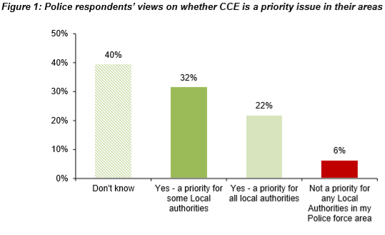
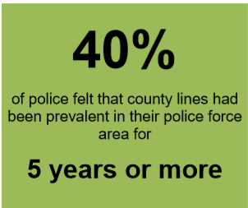
How well local agencies are positioned to safeguard children who are criminally exploited
Notes:
The first one to consider is that local safeguarding agencies have not yet positioned themselves well to tackle child criminal exploitation. What we have found out that around 40% of police staff who we surveyed for the research said that they had seen county lines operations in their areas for at least five years.
But there perception of whether child criminal exploitation was a priority in their area varied. With 40% of respondents saying that they do not know if CCE is one of priority issues for multiagency responses in their areas and 32% saying that it is a priority for some LAS within the boundaries of their police force.

Slide 8
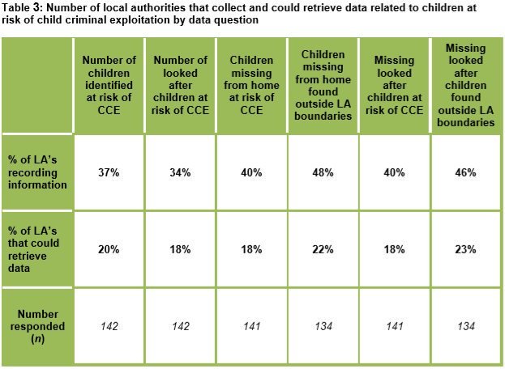
How well local agencies are positioned to tackle child criminal exploitation
Only 1 in 3 local authorities have a local strategy in place on how to safeguard children from child criminal exploitation
Notes:
But when we asked local authorities, only one in five could tell us that they collected and could share any of data on children who are affected by child criminal exploitation. And only one in three had strategies in place to tackle the issue.

Slide 9
Children vulnerable to child criminal exploitation
Any child can become a victim of exploitation. It is through the combination of factors that children become exploited, criminally or in any other way. These factors include:
The child’s own vulnerability
Vulnerability created by society
The presence or lack of protective factors in child’s life
The proximity or access a perpetrator has to a child.
Notes:
The second message is that any child can be vulnerable to child criminal exploitation, of course there are children who are specifically vulnerable and we will talk about them in a moment.
But what we also heard from professionals on the ground, was that criminal networks are very good at changing their tactics as professionals become better at identifying vulnerability. And focusing on vulnerability alone may not be the right approach. Professionals report of instances where younger children, primary aged school children are being targeted. We have heard previously about children go missing to a different area, going missing for longer. It’s changing, children may be going missing for short periods of time, they may be skipping lessons. We've heard of instances where they are making themselves sent out of classroom because they have this shift to run to deliver drugs locally. And I think it’s really important that we don’t just focus on known vulnerabilities but keep our eyes open to be able to identify these new patterns, identify any children who are vulnerable.
Any child can become a victim of exploitation. It is through the combination of factors that children become exploited, criminally or in any other way. These factors include:
The child’s own vulnerability
Vulnerability created by society
The presence or lack of protective factors in child’s life
The proximity or access a perpetrator has to a child.

Slide 10
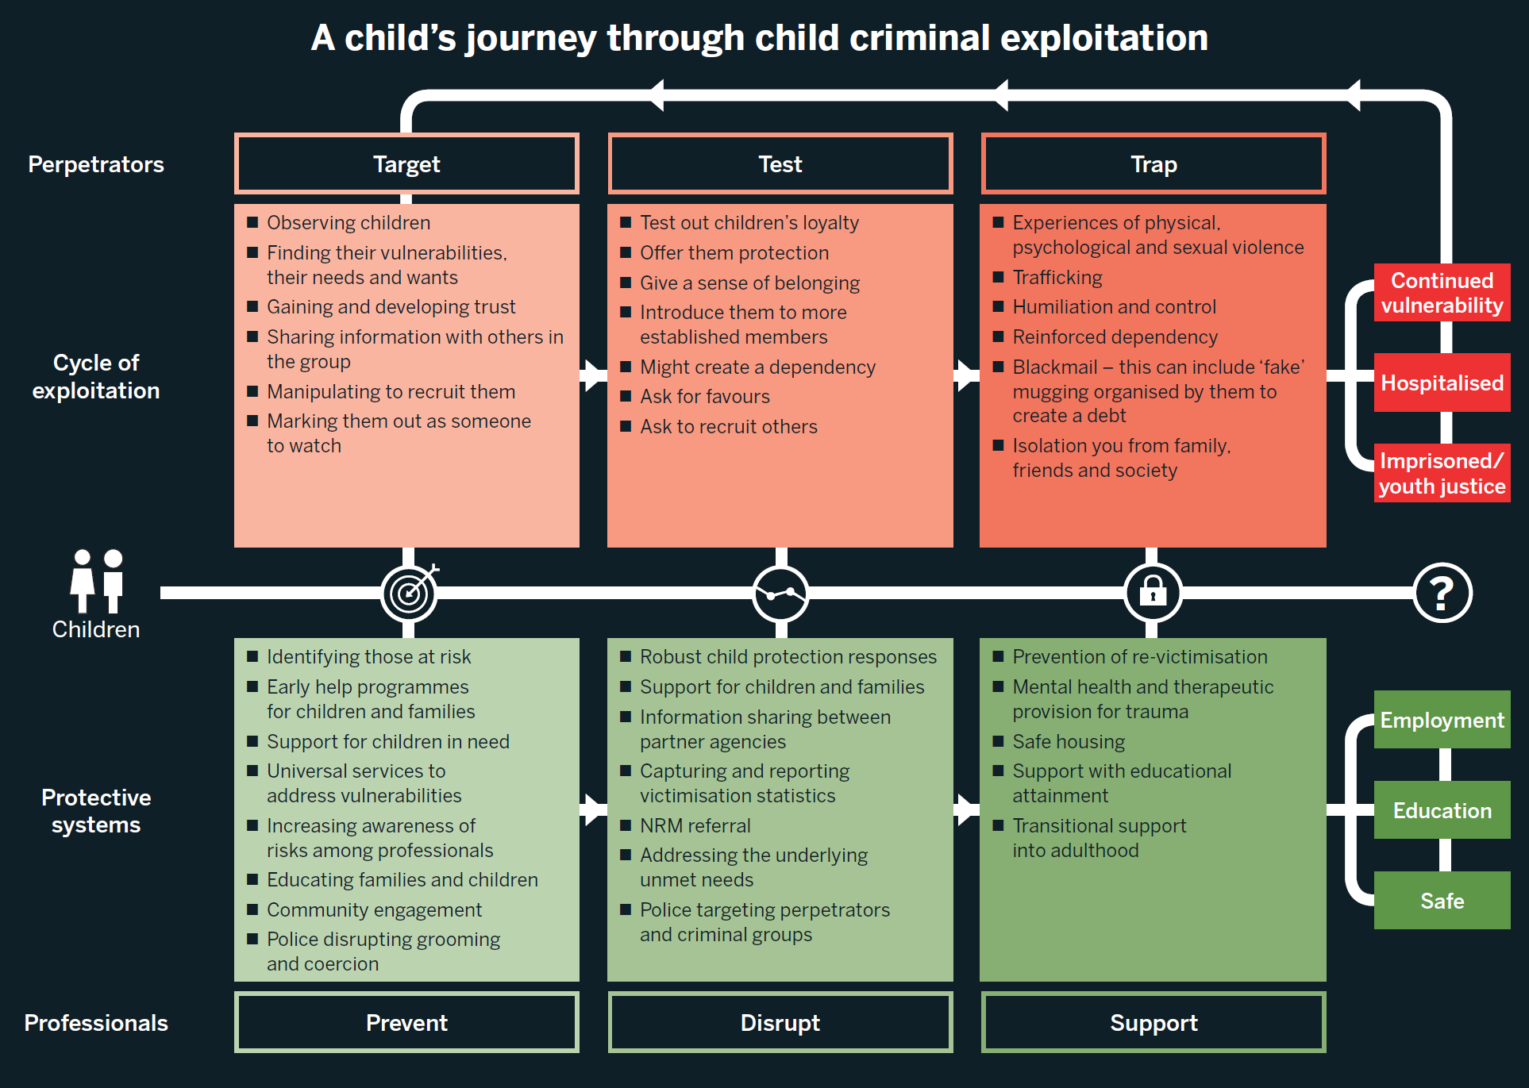
Notes:
The professionals who we interviewed for our research were explaining the cycle of child criminal exploitation through stages. There is a stage of children being targeted, the stage of being tested by gangs and the stage of being trapped. And what they were saying, very often children are found out to be exploited when they are already trapped and we need to do more to start addressing the issue when they are targeted or even before that and train professionals to understand that these children are not making choices because there’s so many different ways criminal networks can coerce, control, force, manipulate these children.

Slide 11
Key trends through our services:
ACEs and unmet needs e.g. domestic violence, recent bereavement, adult substance misuse and poverty present in the lives of the young people we support​
County lines is not the only form of criminal exploitation
Symptoms of PTSD in children returning from missing episodes not being recognised​
Spike in 12/13 year olds missing​
Children are being targeted at PRUs, Childrens homes and unregulated accommodation
Parents desperate for help, feeling pushed out of CP process, are being blamed and do not know where to go to for support. ​
Digital collateral widely used​
Drug debts and debt bondage used to exploit young people and their families
Re-victimisation

Slide 12
Local Recommendations
Children at risk of child exploitation should always have a strategy meeting called about their needs, and a safeguarding and disruption plan developed for the child and their family. These meetings should happen regularly and continue to happen when a child is missing.​
Local authorities and the police should be able to flag on each other’s systems where children are at risk of child exploitation, e.g. on the police national computer ​
All children who go missing should receive a RHI and intelligence from this interview shared with agencies to build up a profile of need in the local area
All professionals should use appropriate language in practice
Children should not be criminalised as a first resort, and criminal prosecutions should not be progressed whilst a referral to the National Referral Mechanism is taking place
Consider the context around the young person

Slide 13
Recommendations from our research
At the national level
National strategy
Changes in legislation to ensure that children are seen and treated as victims of exploitation
Better data collection to understand the scale
At the local level
Local mapping
Creating pathways for children to access support
Notes:
we have some recommendations as the result of this research, what we would like to see in place. Firstly, we need to tackle child criminal exploitation at the national level because county lines criminal exploitation is something that one area with good practice cannot resolve, because it goes across the borders. We need a national strategy, we also need changes in legislation so that all professionals across all the agencies are talking the same language and take safeguarding approach to children. And we know that children’s services need funding because services have experienced lots of cuts.
But we don’t need to wait for those national changes to happen to make change locally, there are some steps that local areas can start taking right now. I talked about this first finding about not knowing how many children are affected, I think it is possible for local areas to do local mapping to understand the scale of the issue in their area and understand who is vulnerable as a result and that should be a priority for the new safeguarding partnership arrangements locally, where they should start looking at how many children may be affected.
And specifically focusing on those children who may be hidden. I mentioned children missing from education, very often they are not reported as missing to the police, the police would not be aware of them. Information about them may not necessarily come up anywhere apart from school who would know that these children were going missing just for two or three hours. So what do we do with this information? How is this information collected locally and informing those safeguarding strategies?
We also need referral pathways for those children for safeguarding response to happen and there have been many different things mentioned here by previous speakers. Exclusion from schools is an interesting one because very often this is done separately from any safeguarding assessment of the needs of children. And the child may be already exploited at that time or they may become exploited shortly after, but there’s definitely a safeguarding need and we need these assessment of needs to happen when decision is made to exclude a child from school.
But also there are other points in the system where that safeguarding assessment needs to happen, at the point of arrest, for example, when the child is arrested with drugs. It is a safeguarding issue children carrying illegal drugs in their bodies. It's definitely a safeguarding issue. Sometimes it’s when they bring that first knife into college or school, that’s a safeguarding issue and there should be a referral pathway for a safeguarding assessment at that point.

Slide 14
The Children’s Society’s national programmes
Disrupting Exploitation programme
Works in Birmingham, Greater Manchester and London providing long-term one-to-one support for children who are vulnerable to or victims of child criminal exploitation and on changing systems and contexts that put children at risk of exploitation.
Prevention programme
A network of 10 specialist Prevention Officers, each covering a designated policing region across England and Wales. The Prevention Officers work in partnership with multi-agency professionals
Tackling child exploitation
A consortium, led by Research in Practice, together with The Children’s Society and University of Bedfordshire
Notes:
What is TCS doing to address the issue
National Programmes
The Children’s Society currently runs (or is a part of running) three national programmes focused on the disruption, prevention and tackling of child exploitation.
Disrupting Exploitation
The Disrupting Exploitation programme works in Birmingham, Greater Manchester and London providing long-term one-to-one support for children who are vulnerable to or victims of child criminal exploitation and on changing systems and contexts that put children at risk of exploitation.
Each region has a multi-disciplinary response team, including case workers and insight and engagement officers. In London the programme also have a therapist and student therapist who works with parents of children who have been exploited. Our systems change work is broken down into four areas – contextual safeguarding, professional training, policies and procedures, and intelligence and information. The programme can accept referrals for both one-to-one case work and systems change work.
‘Systems change’ is about changing the systems that are not protecting young people properly. Systems can include people, resources and services, as well as relationships, values and attitudes. Systems change is a process which hopes to change the different parts and structures which might mean young people aren’t believed, protected or get access to the right support. It is often defined as: changes in organisational policies and procedures, cultures and relationships and is designed to have a lasting and sustainable impact in how children are protected.
Systems change in action
Across our programme and indeed wider Children’s Society services we were consistently supporting children who were being arrested for crimes linked to their exploitation. Primarily this was Possession with Intent to Supply, but also included possessing a knife, shoplifting and assault. Our national research has recently found an XXX% rise in PWITS arrests across England and Wales.
Working in partnership with the Police we took on a systems change challenge which is likely to last the whole of our three-year programme, how can the point of arrest be a teachable/reachable moment for both the young people but also custody staff and arresting officers to see the whole child, alongside any offence they may have committed – which I should say we don’t deny!
This programme allowed us to think creatively. We started by understanding the problem in greater depth – we reviewed the cases of young people arrested and crucially were given permission to shadow 12 hour shifts in custody, to learn and to understand the pressures of the role and get under the skin of the system of custody and its limitations.
Since then the Disrupting Exploitation Programme has led on two initiatives, tracing the journey of a young person through custody, identifying points where the young person’s vulnerability may be missed, we trained over 1,000 MET custody officers. Following this we have provided the MET with some resources to support the engagement between custody officers and children in custody. We have supported them to upgrade the books they offer to young people in custody, disseminated a language guide to custody and got orange squash added to the procurement list for custody! Sometimes it can be the small things that can change the interaction and open up a young person to believing we are on their side.
Secondly, we have started a pilot in a London borough, in partnership between a custody staff and children’s services. We know that in the moment of arrest police have limited information about vulnerability and the agencies that do are hard – or impossible – to get hold of. We have brokered a pilot where 6 safeguarding questions are asked and answered by children’s services when a child enters custody. Not only does this help custody staff stay curious and understand the young person in front of them in greater depth, but it helps information about what happens in custody leave custody and get in the hands of children’s services to then support a longer-term safeguarding response. We’re excited about where this pilot might take us, and have other local custody suites and councils interested in replicating this model. If you want to know more please do come over to our stall later.
Prevention Programme
Following the success of the first Prevention Programme which ran April 2017-March 2018, The Children’s Society have been re-funded by Norfolk Police and Crime Commissioner for another year until March 2020, to deliver a programme aimed at preventing and lowering incidences of Child Sexual Abuse and Exploitation, Child Criminal Exploitation, Modern Day Slavery and Human Trafficking on a regional basis across England and Wales.
The programme consists of a network of 10 specialist Prevention Officers, each covering a designated policing region across England and Wales. The Prevention Officers work in partnership with multi-agency professionals including Regional Organised Crime Units, Health, Education, Social Care and other Voluntary, Community and Faith sector organisations to:
Identify hot spot locations, priority areas and specific threats in each region.
Deliver targeted activities using contextual safeguarding approaches
Provide tactical advice to safeguarding and disrupting abuse, exploitation, modern day slavery and human trafficking
Co-ordinate the involvement of relevant local organisations to avoid duplication
Collect intelligence and bring insight on the current nature of these threats through partnership engagement
Help bridge gaps in evidence based knowledge
The programme will run on a tasks basis and tasks are received from a range of partners or are identified directly by the Prevention Officers, where possibly they will work collaboratively with other TCS teams such as Disrupting Exploitation and the Tackling Child Exploitation Teams.
Tackling Child Exploitation
A consortium, led by Research in Practice, together with The Children’s Society and University of Bedfordshire, was appointed in April 2019 to develop and deliver a new programme to tackle child exploitation.
The Tackling Child Exploitation (TCE) Support Programme is funded by the Department for Education and aims to support local areas to develop an effective strategic response to child exploitation and threats from outside the family home, including child sexual exploitation and child criminal exploitation, such as county lines drug trafficking.
The TCE Support Programme is for local area partnerships with safeguarding responsibilities. It is designed to provide some extra support so that local areas can review and develop their strategic approach to safeguarding children and young people experiencing extra-familial harm and exploitation.
The TCE Support Programme will help local areas in two main ways:
Developing and delivering a bespoke support programme, which entails providing time-limited projects in local areas.
Providing an online open-access resource containing evidence-informed materials, such as knowledge briefings and tools, to support local areas to develop their strategic response to extra-familial harm and child exploitation.
You can, if you are a senior leader acting on behalf of your local area partnership, apply for bespoke support when the application process opens in October 2019.

Slide 15

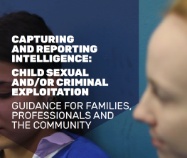
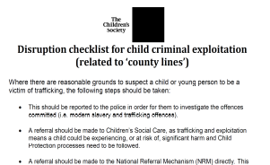
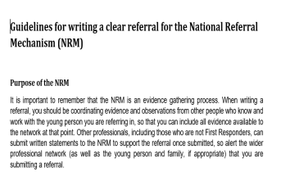

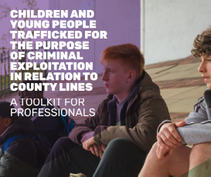
Our resources and support
Intelligence Guide
Guides for parents
Disruption checklist
NRM guide
Language guide
CCE Toolkit
Notes:
These are some of the resources we have created across our programmes.​
​
Intelligence guide – we created this piece of guidance to share with families, communities and professionals to encourage intelligence sharing. One of the main gaps that of course comes up time and time again is that there is an intelligence gap. We are not saying this is going to solve all of those problems but it is a simple guide of two or three pages that explains what intelligence is, why its important to share and examples of types of intelligence such as car number plates, places and locations, method of travel, businesses and so on ​
​
Guide for parents – this is a two sided document for parents who may be worried that their child is being criminally exploited. ​
​
Disruption checklist – this is a document we use in our practice teams when attending safeguarding meetings. There are questions on there that remind us about disruption as well as safeguarding a young person – it encourages us to ask questions about the contextual environment, other pieces of intelligence to share, if NRM has been completed, if police from out of area have shared intelligence, whether police have considered different powers to disrupt ​
​
NRM guide – we created this short simple guide for first responders to use when completing an NRM referral. Last week at a conference we heard that 60% of NRM referrals are returned because they haven’t been completed properly. We hope this guide will be used to support professionals to submit better quality of referrals ​
​
Language guide – unfortunately young people are still being blamed for their own exploitation and underpinning this is the language that professioanls use. We created a guide that describes unhelpful and helpful language. We use this in our own practice to reframe young people as victims of exploitation ​
​
CCE toolkit – we created this back in 2017 as at the time there was no guidance for professionals in responding to criminal exploitation particularly the county lines model. This is a useful guide for professionals working directly with a young person who is being criminally exploited – including what to do/not to do, the importance of disruption and safeguarding at the same time and includes a combination of NRM, language and intelligence guidance ​
​
I haven’t got a picture of it but we have recently published our counting lives report which is a national report about responding to victims of criminal exploitation. We are struggling to keep up with the scale and context of criminal exploitation. The response from statutory agencies is too variable and often comes too late. Children are being too easily criminalised, and are not viewed as victims of exploitation. There is also a concerning lack of data and reporting about children at risk of criminal exploitation. The report is a call to action for professionals to recognise child criminal exploitation and provide a coordinated safeguarding response.​
​
​
We will send all of these out electronically and they are also available on our website.

Slide 16
Thank you
Lucy.belcher@childrenssociety.org.uk
Follow on:
Twitter: @lucybelcher6
Find us on: facebook.com/childrenssociety

